Slide 1

DNA

Slide 2

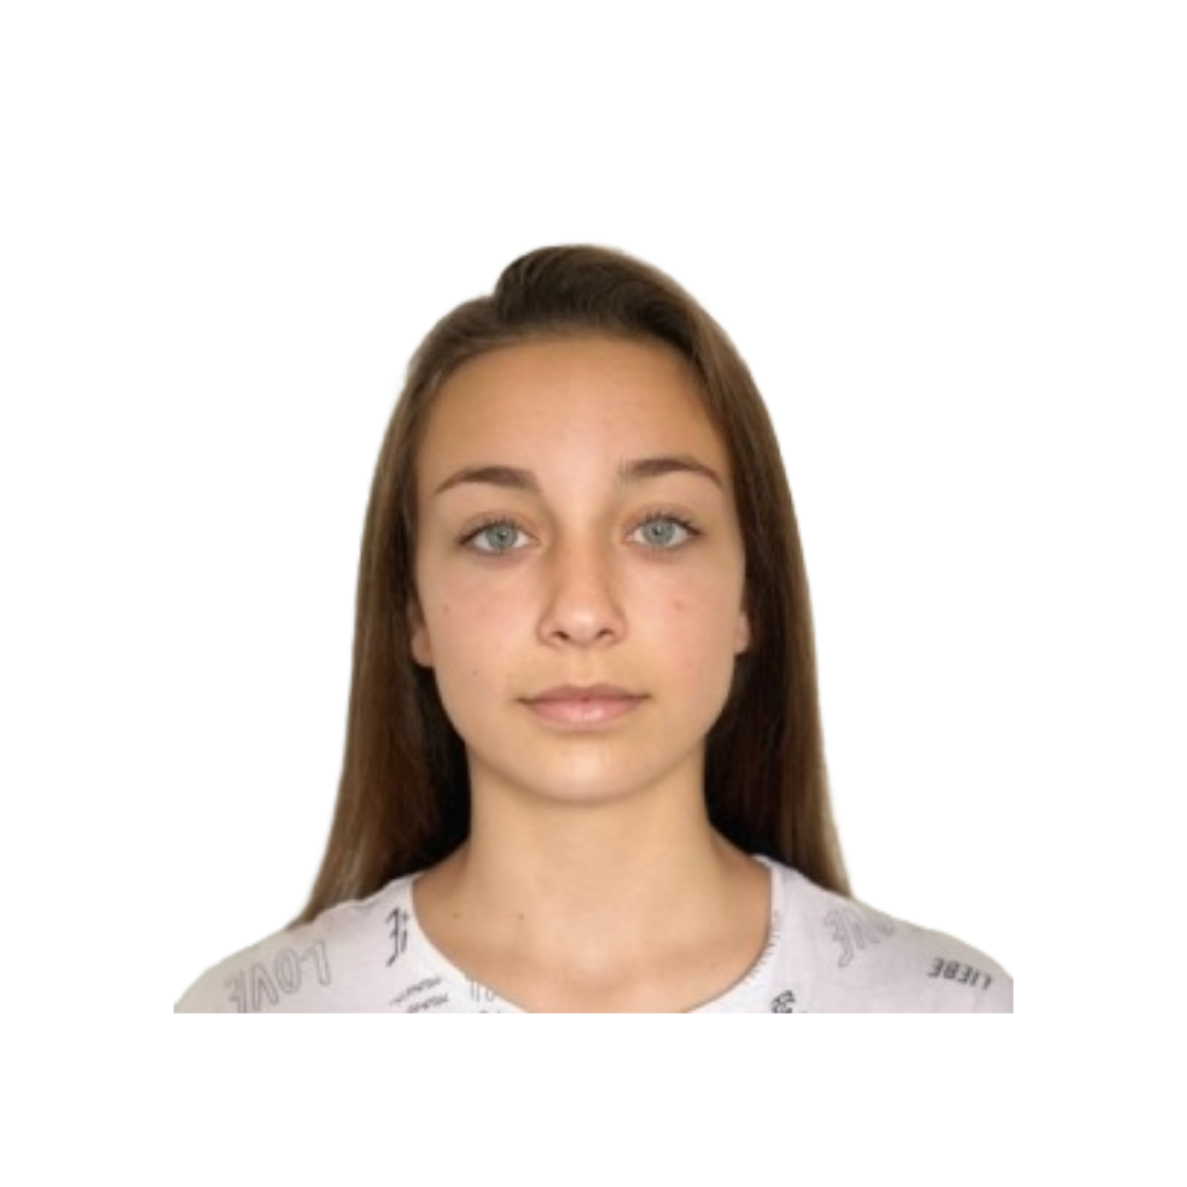
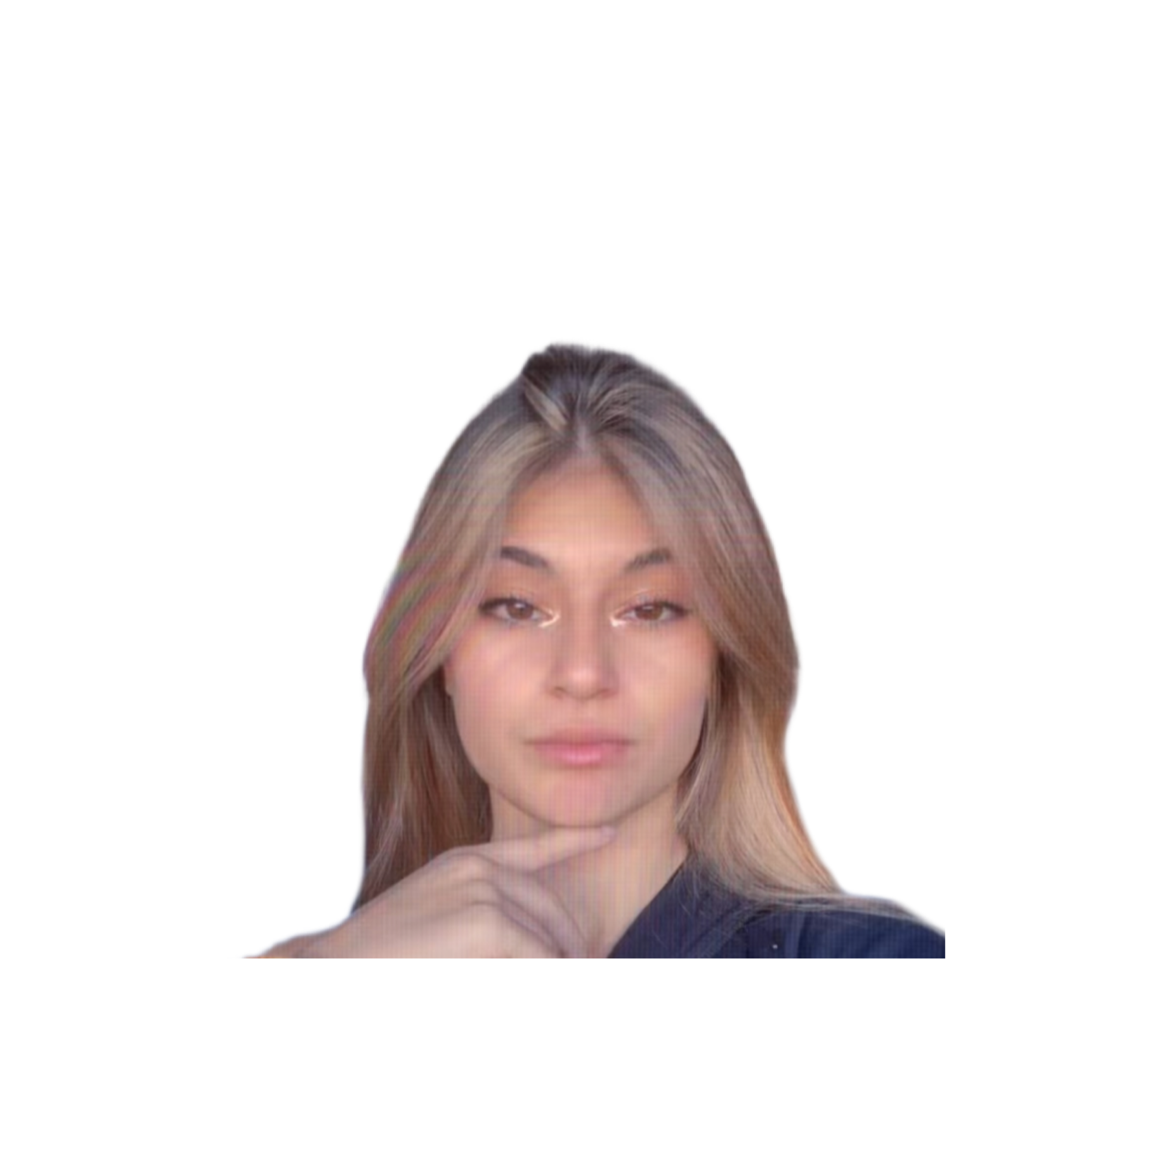
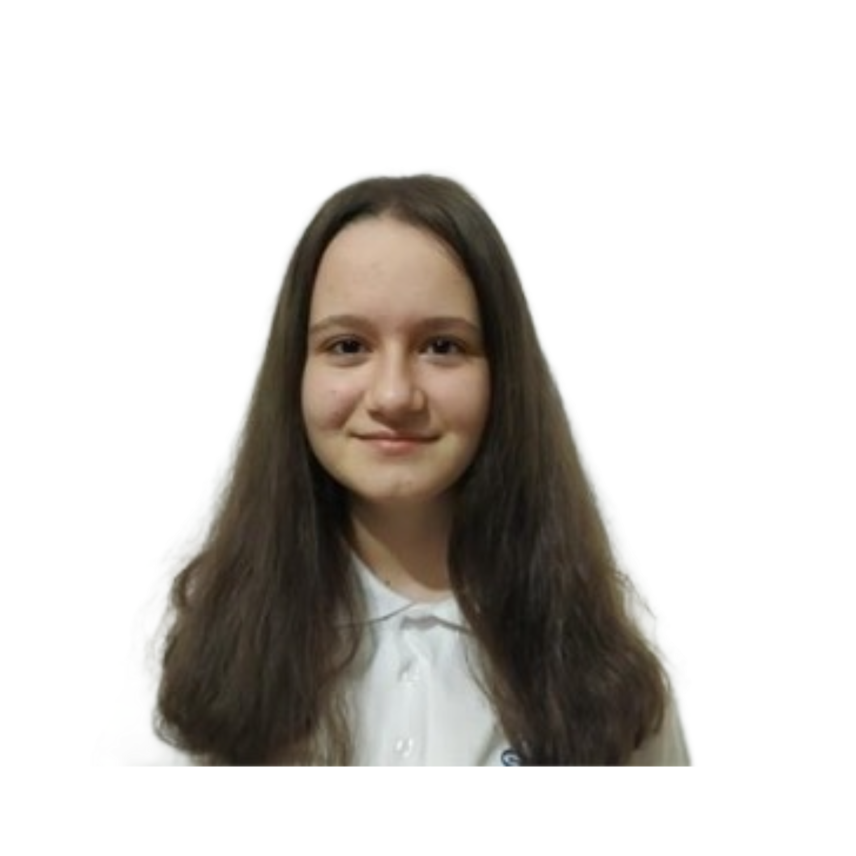
Любомир Георгиев
SCRUM TRAINER
Лорена Христова
DESIGNER
Красимира Русева
BACKEND DEVELOPER
Тони Чоджорова
BACKEND DEVELOPER
DNA

Slide 3

STAGES OF WORK
01
02
03
findig teammates
distribution of roles
working on the project
04
final project
DNA

Slide 4
OUR IDEA
GAME PHOTOS...
DNA

Slide 5






TECHNOLOGIES
DNA

Slide 6
Thank you!
DNA

